Slide 1

Data Science Challenges and Opportunities in Building Energy Automation
IEEE SERVICES, 8th of September 2021
Jan Drgona
Collaborators: Elliott Skomski, Soumya Vasisht,
Aaron Tuor, Draguna Vrabie

Slide 2
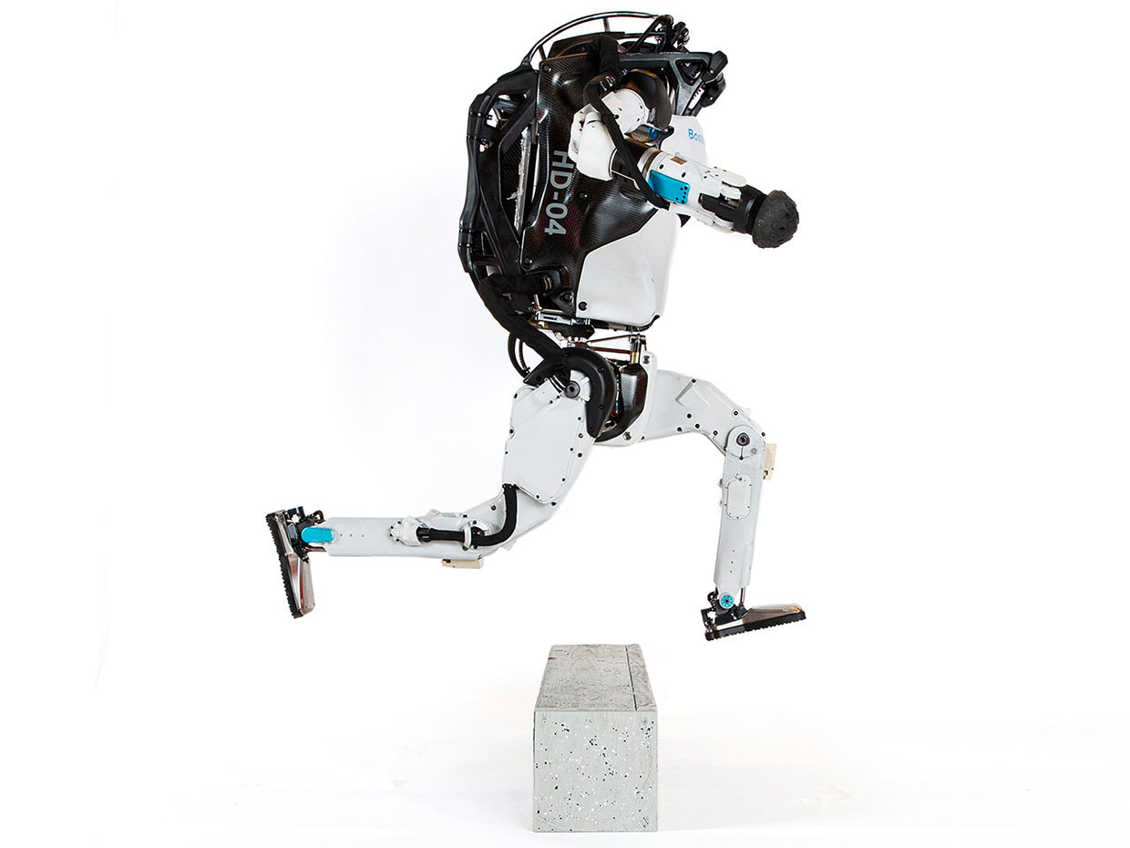


Model-based Optimal Control
Successes
Challenges
95% of the process control applications are PID loops using trial and error rule-based optimization. The rest is model predictive control (MPC).
Modeling
Physics-based modeling is expensive
Purely data-driven models lack generalization
Data
Low resolution, missing datapoints, data labeling
Lack of standardization and benchmarks
Deployment
Hardware limitations, offline vs online optimization, parallelization, distributed computing
Assumption:
Reliable and accurate system dynamics model
Drgona J., J. Arroyo, I.C. Figueroa, D. Blum, K. Arendt, D. Kim, and E.P. Olle, J. Oravec, M. Wetter, D. L. Vrabie, L. Helsen. 2020. "All You Need to Know About Model Predictive Control for Buildings." Annual Reviews in Control, September 29, 2020
Notes:
Domain awareness, trusted autonomy
PID controller-
A PID controller continuously calculates an error value
the difference between a desired setpoint (SP) a process variable (PV) and
Correction based on proportion of error, integration of accumulated error, and derivative of the error
MPC first developed in the chemical industry to address some of the shortcomings of a PID controller.
Designed to handle MIMO systems
Can handle constraints
Preview capability
MPC uses a model to predict future outcomes of a process.
Online optimization problem at each process interval. Performs first action in the rollout.
requiring large memory and fast processor to operate in real time.
Training and calibration of models- lots of expert time
Optimization: translation to a solver language- lots of expert time
Computational limitations of control hardware depending on the system

Slide 3
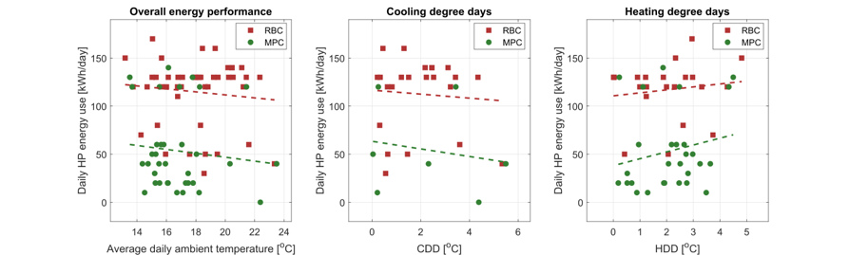
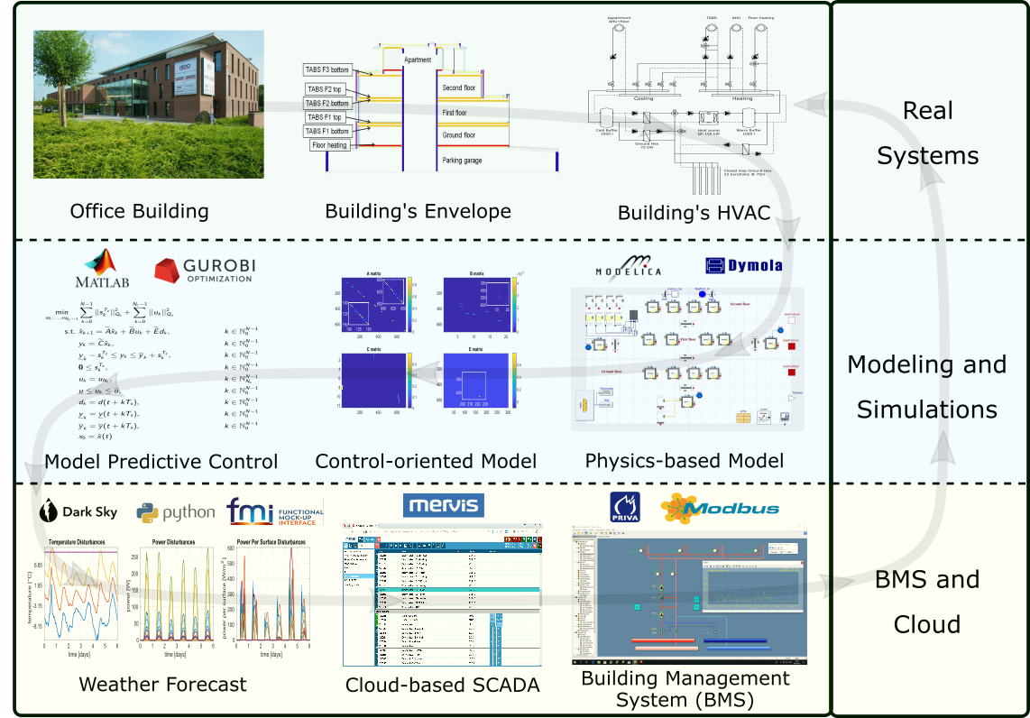
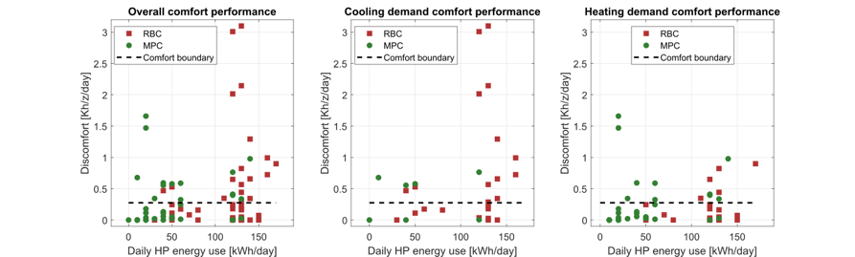

Implementation of MPC in Office Building in Belgium
The field test energy use performance of MPC (green) and RBC (red) during the transient season. Each dot represents one day.
The field test thermal comfort performance of MPC (green) and RBC (red) during the transient season. Each dot represents one day.
Highlights: Heat pump energy savings up to 53%.
Thermal comfort improvement up to 37%.
Drgona J., et al., Cloud-based implementation of white-box model predictive control for a GEOTABS office building: a field test demonstration. Journal of Process Control, 2020.
Notes:
To better understand the complexity of the task, lets walk through a complete workflow as implemented for a practical use case to control an office building in Belgium.
This office building is equipped with thermally activated building structures with a geothermal heat pump (GEOTABS). These kinds of buildings are known to be very challenging to control due to the large thermal mass and associated time delays. For optimal operation of this type of systems, predictive control is an absolute must.
First one develops a high-fidelity physics-based model based on the available engineering documentation and measurement data.
Then the control-relevant equations are extracted and used to construct an optimization-based predictive controller.
The optimized controls are computed every 15min based on new weather forecast and new measurement from the building, then the controls are communicated to the building management system for execution.
The whole procedure takes approximately a minute to execute in real time.
After using the MPC in the office building for a couple of months the team measured more than 50% energy savings on the heat pump and improved thermal comfort by approximately 37%. The rigid and delayed behavior of the rule-based controller is replaced by dynamic and anticipatory behavior of MPC, which keeps the zone temperatures closer within comfort bounds and delivers cooling only when it is needed.

Slide 4

Differentiable Predictive Control
Predictive, safe, improving, trustworthy, efficient
Jan Drgona, Aaron Tuor, Elliott Skomski, Soumya Vasisht, Draguna Vrabie, Deep Learning Explicit Differentiable Predictive Control Laws for Buildings, IFAC NMPC 2021
Jan Drgona, et al., Differentiable Predictive Control: An MPC Alternative for Unknown Nonlinear Systems using Constrained Deep Learning https://arxiv.org/abs/2011.03699
Jan Drgona, Aaron Tuor, Draguna Vrabie, Constrained Physics-Informed Deep Learning for Stable System Identification and Control of Unknown Linear Systems https://arxiv.org/abs/2004.11184
Notes:
Generic method for constrained model-based control
Can be trained end-to-end from time series dataset
Nonlinear constrained optimal control
Explicit neural network-based control policy
Scalability beyond the limitations of explicit MPC

Slide 5
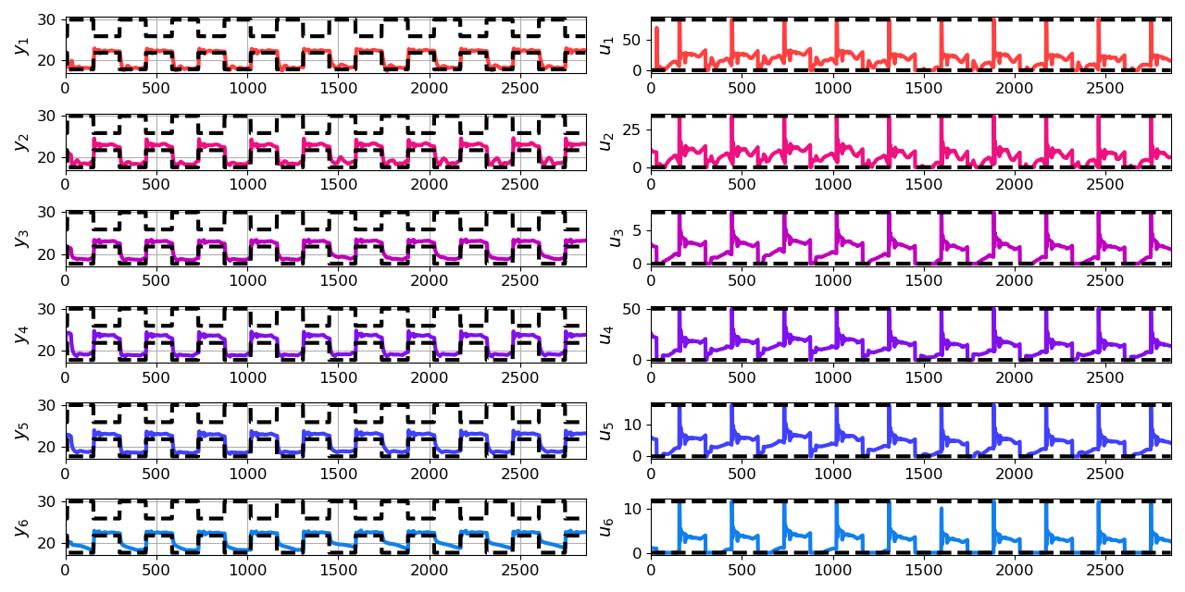
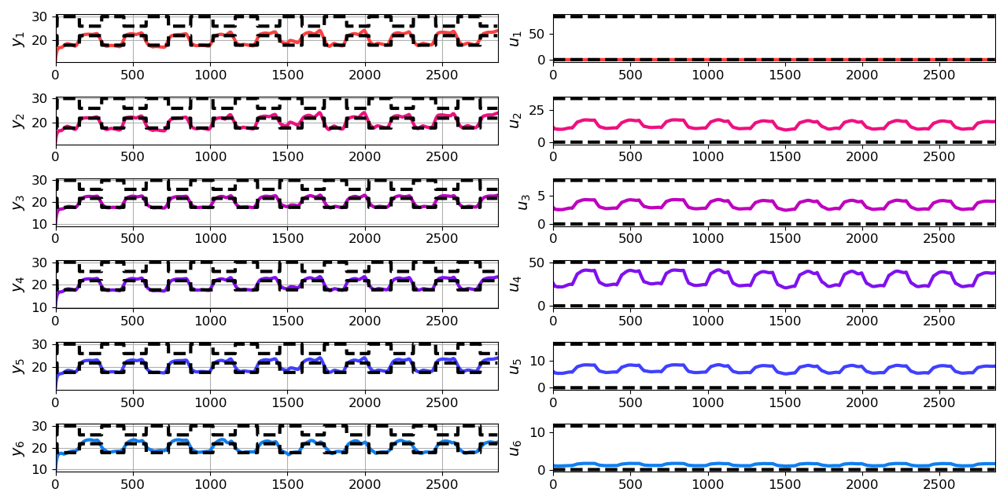
Closed-loop DPC of Multi-zone Building
Jan Drgona, Aaron Tuor, Elliott Skomski, Soumya Vasisht, Draguna Vrabie, Deep Learning Explicit Differentiable Predictive Control Laws for Buildings, IFAC NMPC 2021

Slide 6
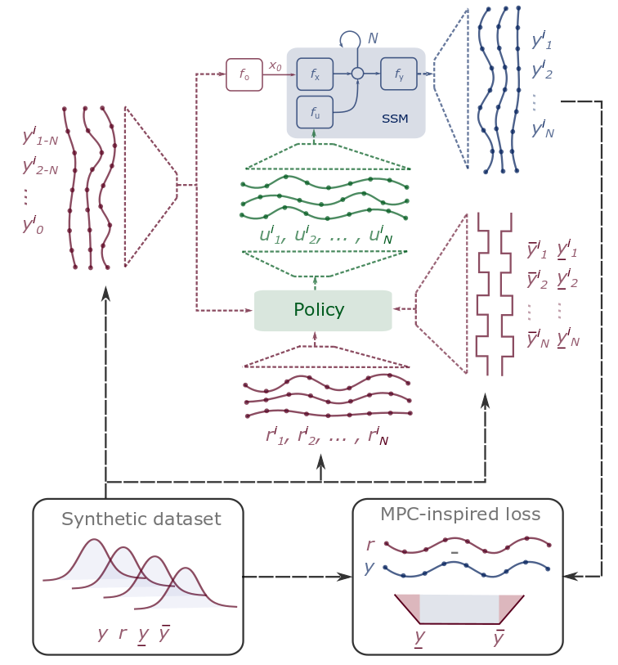
Conclusion
Differentiable Predictive Control
Differentiable system models
Explicit control policies
State and input constraints
Learn offline, act online
Open-source Code
Neuromancer software package
https://github.com/pnnl/neuromancer
Structured linear maps in Pytorch
https://pnnl.github.io/slim/
Jan Drgona, et al., Differentiable Predictive Control: An MPC Alternative for Unknown Nonlinear Systems using Constrained Deep Learning https://arxiv.org/abs/2011.03699
Jan Drgona, Aaron Tuor, Draguna Vrabie, Constrained Physics-Informed Deep Learning for Stable System Identification and Control of Unknown Linear Systems https://arxiv.org/abs/2004.11184

Slide 7
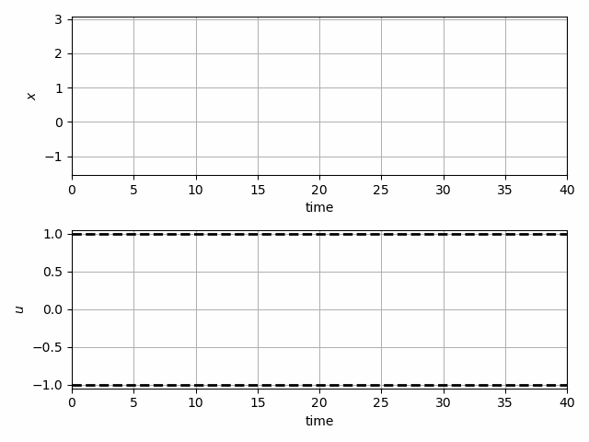
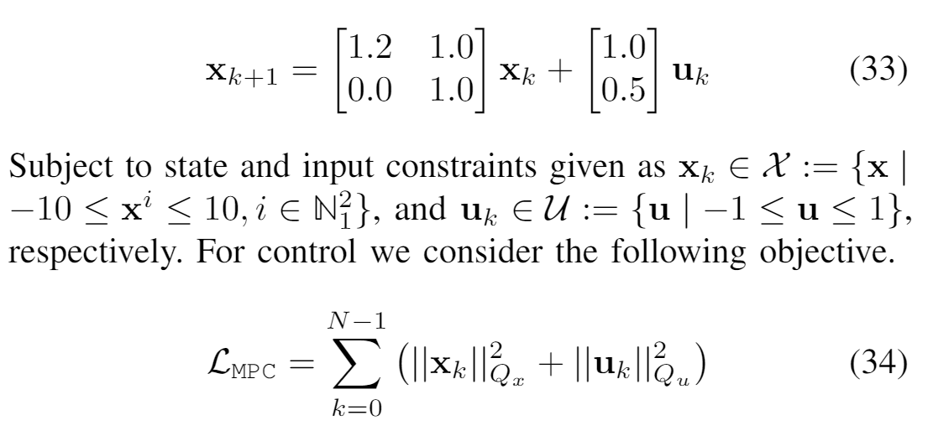
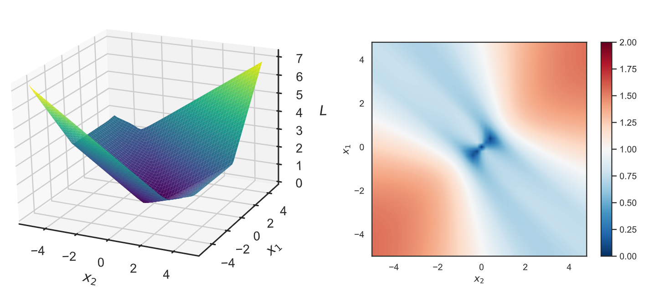
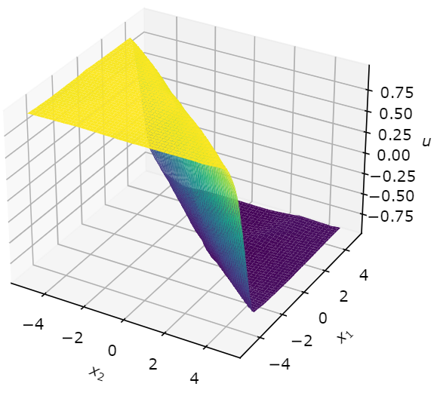
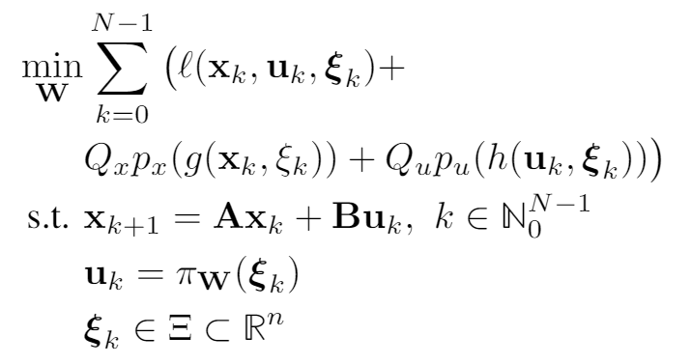
Learning to Stabilize Unstable System with DPC
Problem setup:
DPC formulation:
Drgona J., Tuor A., Vrabie D., Learning Stable Adaptive Explicit Differentiable Predictive Control for Unknown Linear Systems, under review, 2021

Slide 8
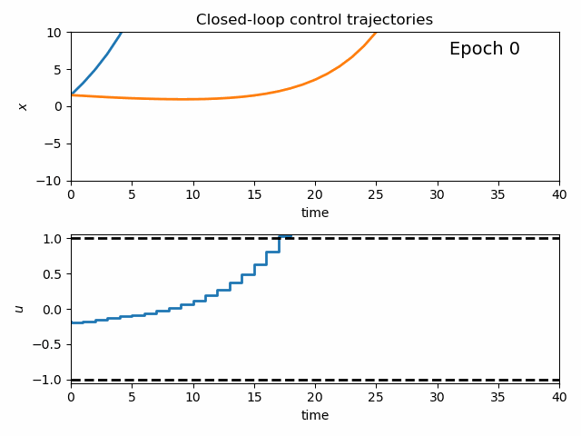
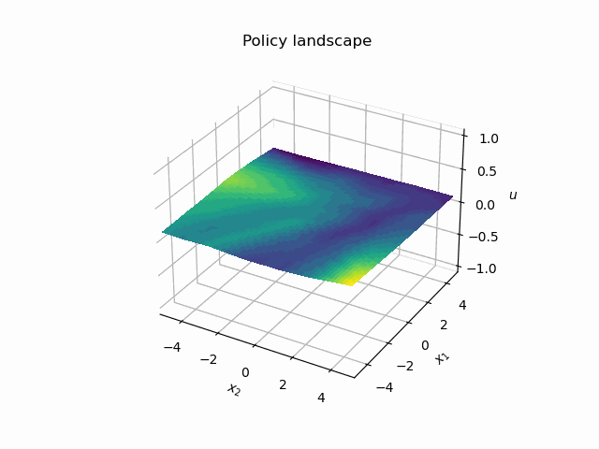
Dynamics of DPC Control Policy Learning
1341 learning parameters, 48.2 seconds offline training time on a CPU with 200 epochs.
Notes:
analyzing evolution of the controller during learning
Trajectories
Policy landscape
State space regions

